Slide 1

PROJECT PROPOSAL ON MOVIE TICKET BOOKING SYSTEM
BY SUHANA SHAKYA & SARINA GOLE

Slide 2
INTRODUCTION
OBJECTIVES
This project, titled Movie Ticket Booking System, is a web-based system designed to allow users to browse movie, choose cinema halls, view showtimes, select seats, and book tickets online through a simple and user-friendly interface.
To provide a centralized platform for multiple cinema halls.
To display available movies and show schedules.
To enable seat selection and ticket booking.

Slide 3
SCOPE
The system will:
Support multiple cinema halls.
Allow users to browse available movies.
Display show schedules and ticket prices.
Provide seat selection functionality.
Provide an administrator panel for managing movies, halls, and show schedules.

Slide 4
Functional Requirement
NON Functional Requirement
User Module
View movie details and cinema halls showing selected movies.
Book movie tickets.
Administrator Module
Add, update, and delete movies.
Manage cinema halls and show schedules.
The system should respond to user requests within a few seconds.
Authentication should be required for booking operations.
The interface should be simple and user-friendly.
The system should be accessible whenever users need to book tickets.

Slide 5
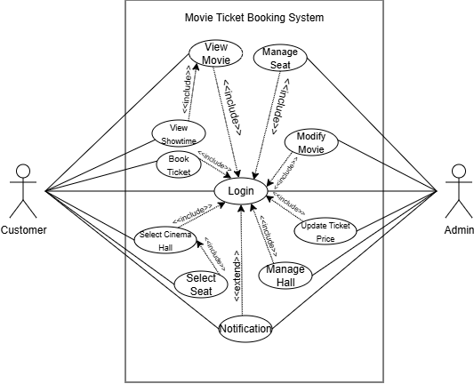
USECASE DIAGRAM

Slide 6
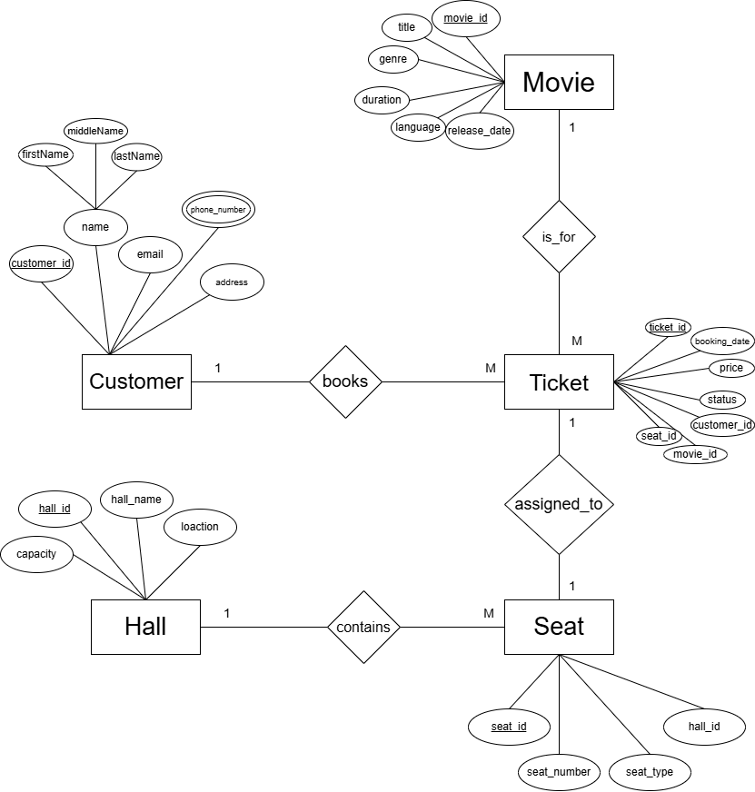
ENTITY RELATIONSHIP DIAGRAM

Slide 7
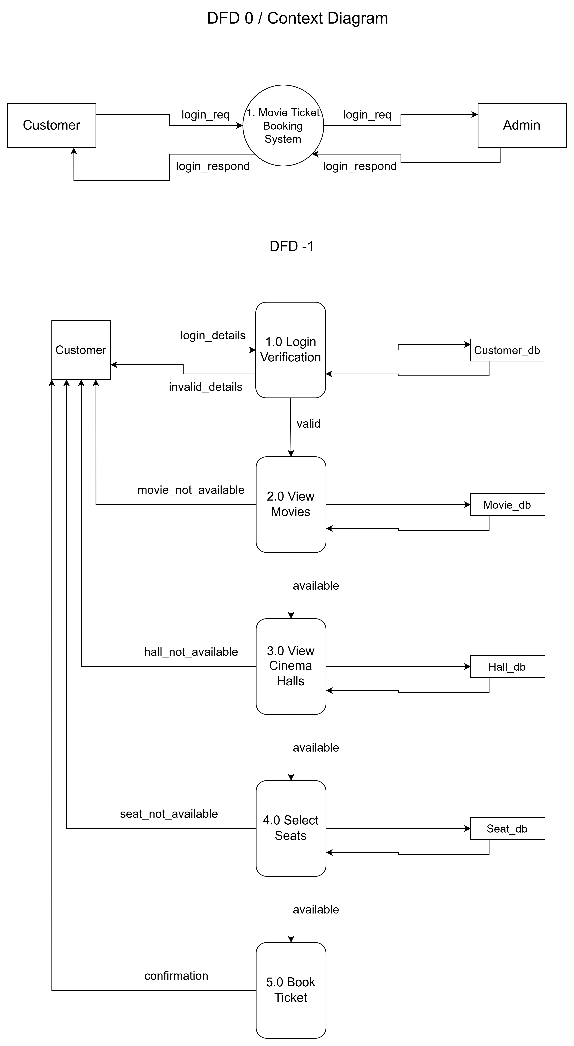
DATA FLOW DIAGRAM

Slide 9
Feasibility Study
Technical Feasibility
ECONOMIC Feasibility
OperAtional Feasibility
The Movie Ticket Booking System can be developed using technologies such as: HTML, CSS, JavaScript for Frontend, PHP for Backend, MySQL for Database & XAMPP Server.
The project relies entirely on open-source and freely available technologies.
Minimal recurring costs
Long-term benefits
Relatively low investment required
Easy user adaptation as they are already familiar with basic web navigation and similar ecommerce booking style

Slide 10
SYSTEM DEVELOPMENT TOOLS
i. Front End Development
HTML will be used to build the structural components of the interface, such as movie listing pages, seat selection layouts, and login/registration pages, while CSS will handle the visual presentation, including colors, fonts, and spacing.
ii. Back End Development
PHP will handle core functionalities including user authentication, validating user input, implementing booking logic (such as checking seat availability before confirming a booking), and connecting to the MySQL database to retrieve and store data.
iii. Database
MySQL will store all persistent data related to users, admins, movies, theaters, shows, seats, bookings, and payments, structured according to the ER model described

Slide 11
CONCLUSION
The proposed Online Movie Ticket Booking System will provide a centralized platform for booking movie tickets across multiple cinema halls. Users will be able to view movies, compare showtimes, select seats, and book tickets efficiently. Cinema administrators will be able to manage movies, schedules, and booking records through a dedicated administration panel.

